Slide 1
Recursion
ECS 30

Slide 2

Recursion - Definition
Something is recursive if it is defined in terms of itself
This seems kind of weird because most things in life aren’t like this
There are some things in math and computer science that are defined like this and recursion makes solving this problems very easy
Fractal broccoli might be said to be recursive as it has heads that are made up of heads

Slide 3
Recursion Example
Think about how you would define if someone is your ancestor
Well we know that your parents are your ancestors
We also know that your parents’ parents are your ancestor
As well as your parents’ parents’ parents
We could say someone is your ancestor if they are your parents or one of your parents’ ancestors
Bool isAncestor(Person* ancestor, Person* person){
if(ancestor == NULL){ return false;}
else if(person->mother == ancestor || person->father == ancestor){return true;}
else if{isAncestor(ancestor, person->mother){
Return true;}
else{
return isAncestor(ancestor, person->father);}}

Slide 4
Base Case
The base cases are the ones that you can solve right away
You want to come up with these first
In our example these are
Not having a parent
Your mother or father is the ancestor we are looking for
Base cases should be checked first
Many times bases cases have to do with nothing left
Empty string
Empty array
NULL pointer
Bool isAncestor(Person* ancestor, Person* person){
if(ancestor == NULL){ return false;}
else if(person->mother == ancestor || person->father == ancestor){return true;}
else if{isAncestor(ancestor, person->mother){
Return true;}
else{
return isAncestor(ancestor, person->father);}}

Slide 5
Recursive Case
This is where you call your function again
You must believe that your function solves the problem
When calling the recursive function it must get at least one step closer to the base case
This is called well behaved recursion
If this isn’t true you’ll end up with infinite recursion
Many recursive problems use first rest recursion
You take out the first element
Recurse on the rest
Combine the recursion result with the first element
Bool isAncestor(Person* ancestor, Person* person){
if(ancestor == NULL){ return false;}
else if(person->mother == ancestor || person->father == ancestor){return true;}
else if{isAncestor(ancestor, person->mother){
Return true;}
else{
return isAncestor(ancestor, person->father);}}

Slide 6
First Rest Recursion Example
Here we want to find the sum of a list of numbers recursively
First we want to come up with the base case
The simplest list of numbers we could have is a list with no numbers (the empty list)
The sum of 0 numbers is 0
Now the recursive case
The sum of a list of number is the first number + the sum of the rest
Int rec_sum(int* nums, int size){
if(size <= 0){
return 0; }
else{
return nums[0] +
rec_sum(nums + 1, size - 1);
}

Slide 7
Recursion Example - Fibonacci
The fibonacci numbers are defined as follows
F(0) = 1
F(1) = 1
F(N) = F(N-1) + F(N-2)
This is a great time to use recursion as our problem is defined recursively
Base cases are 0 and 1
Recursive case is any number > 1
Int fib(int n){
if(n == 0 || n == 1){
Return 1;
}
Else{
Return fib(n - 1) + fib(n-2);
}

Slide 8
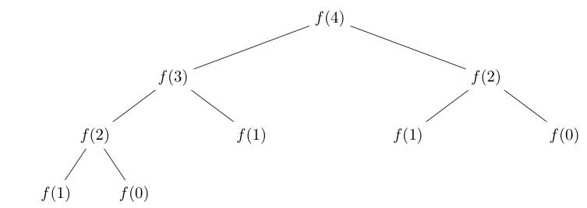
Recursion Example - Fibonacci
On the right is what the stack will look like when calling our function with n = 4
You can see that it is rather inefficient as every recursive function needs to make two more recursive calls

Slide 9
Fibonacci - Improved
Here is an improved version of the code that only makes a single function call in each recursive case
Accomplish this by storing n-1 and n-2
On each call n-2 becomes the old n-1 and n-1 become n-1 + n-1
We also made a nice interface into the function at the bottom to ensure that n-2 and n-1 both start as 1 and 1
Runs much faster and is more efficient
Int _fib(int N, int fibn_2, fibn_1){
if(n == 0) { return fibn_2;}
Else if(n == 1) {return fibn_1;}
Else {return _fib(n-1, fibn_1, fibn_2 + fibn_1);}
}
Int fib(n){
Return _fib(n, 1, 1);
}

Slide 10
Recursive Data Structures
Sometimes the data structures we work with are recursive
For example the Linked List
It is made up of nodes
Each node contains a value and a pointer to the next node in the list
If there is no next node that pointer is NULL
Useful for when you don’t know how many items there are going to be and you’ll normally go through all the items
Bad if you want to pick out random elements from the list as you may have to walk through the whole list to find them
typedef struct Node_Struct{
int value;
struct Node_Struct* next;
} Node;

Slide 11
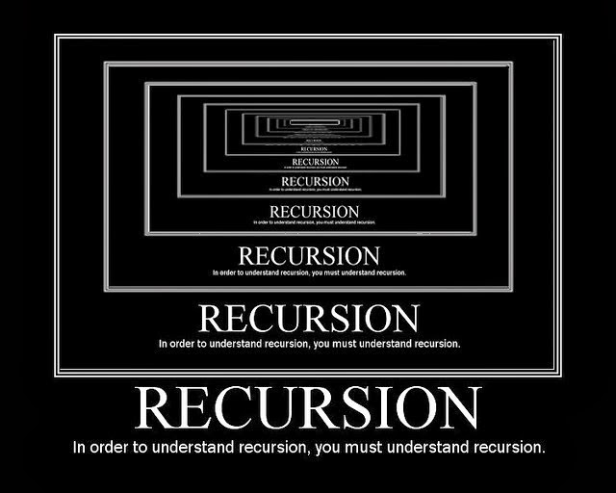
Understanding Recursion
Recursion is a very different way of thinking about problems but very powerful
When working with recursive problems again
Always start with the base cases
Make them as simple as possible
When doing the recursive case don’t forget there is a function that solves the problem you are trying to solve
It just happens to be the one you are writing
Trust that it is correct and believe in yourself

